Slide 1
WELCOME

Slide 2
TIMETABLE MANAGEMENT SYSTEM
GUIDED BY
Mr. S. SRINIVASAN Msc.,MCA.,M.Phil.,(Ph.D.,)
Assistant Professor.
PRESENTED BY
G.BOOMIKA
B.SHINEKA
T.VARSINI
S.KEERTHANA
1

Slide 3
INTRODUCTION
Timetable Management System reduce scheduling conflicts and optimize resource allocation.
This system efficiently handles scheduling and allocation tasks.
This System provides an automated timetable feature and also ensures data security and restricts unauthorized modifications.
This Project aims to provide a user friendly interface and ensures reliability.
2

Slide 4
ABOUT THE PROJECT
Timetable Management System is a software application which reduces the manual effort and save time.
By automating tasks it improves efficiency and preferences to generate an optimized timetable.
Timetable Management System is implemented using VB.NET programming language and SQL database.
This aims to streamline:
The Scheduling Process
Prevent Conflicts
Provide Easy Access
3

Slide 5
EXISTING SYSTEM
The existing system is a manual process done on spreadsheets and paper based schedules.
Timetables are created and updated manually, often involving significant effort and time.
These schedules are written down or stored in computer files.
If there is change in schedule it can take a while to update everything.
This way is old and complicated.
4

Slide 6
DISADVANTAGES
The problem arise when people have to manually input, update and manage class schedules.
This can leads to scheduling conflicts, mistakes and difficulties in adopting to changes quickly.
It leads to constraints problem and inefficiency.
Real time updates are challenging to schedule.
This system lacks scalability and can leads to data redundancy.
5

Slide 7
PROJECT DESCRIPTION
The intention of the system is to generate the timetable automatically.
It enhances productivity and we can reduce the scheduling conflicts.
This system offers a subject allotment feature to ensure the assigned subjects without schedule clashes.
It simplifies complex scheduling tasks, which prevents scheduling conflicts.
Staff and class timetables can be viewed as a report.
6

Slide 8
FRONTEND
Visual Basic.NET is a Web based Application.
This project is implemented using VB.NET programming language.
Drag and drop functionality provides a creation of a powerful and user friendly Timetable Management System.
Robust error handling mechanisms and ensures reliability.
Event driven model for handling user interactions manages timetable generation effectively.
Facilitates integration with backend systems and data sources.
7

Slide 9
BACKEND
SQL Server database serves as the backbone of this Timetable Management System.
This enables efficient management of timetable’s data.
This can integrate seamlessly which allows for efficient data retrieval and updates from the frontend.
This SQL Server ensures data reliability, security, scalability and efficient data manipulation.
All the modules in this project are linked to the SQL database to ensure data persistence.
8

Slide 10
ADVANTAGES
This System automates the scheduling process.
It greatly diminishes the time needed to generate maximum error free timetables.
Prevent scheduling conflicts and optimize resource utilization.
It enhances communication and accessibility.
This system allows user for easy adjustment and rescheduling.
Easily allows to create unique timetable for staff and class.
9

Slide 11
MODULES
USER AUTHENTICATION MODULE
REGISTRATION
The New user has to be registered.
After registration, the system will provide the access rights to work.
ADMIN LOGIN
This authentication module concentrates on the security of the system from unauthorized users.
10

Slide 12
COURSE MODULE
The details about the department are added.
SUBJECT MODULE
Subject details according to the courses selected with CRUD operations are managed.
CLASS MODULE
Information about class details.
Important for generating timetable for both staff and class.
11

Slide 13
STAFF MODULE
Information about the staff is maintained.
Validation controls and CRUD operations are used to manage these records.
SUBJECT ALLOTMENT
This Module provides flexibility.
It detects the conflicts in allocation of subjects to the staff.
And alert the users through an error message.
Prevents scheduling conflicts and using this module Timetable is generated.
12

Slide 14
STAFF TIMETABLE
This is the final timetable generation module.
Based on the details allotted in subject allotment module, the timetable is generated with respect to the ID Number.
CLASS TIMETABLE
Based on the user’s selection the timetable is generated automatically.
Subject allotment module plays an major role.
REPORT MODULE
Admin can collect all the needed information.
For each staff and class the timetable can be submitted as report.
Reduces communication barriers.
13

Slide 15
CONCLUSION
This project delivers a practical and dependable scheduling solutions.
We have designed a user-friendly interface for both class and staff.
Simplifies and streamlines scheduling, subject allotment, and reporting processes.
Reduces the scheduling conflicts with this automated system.
This system helps the academic to improve their procedure of preparing the timetable.
14

Slide 16
FUTURE ENHANCEMENT
Reinforcing security measures and access control.
The subject allotment module will undergo significant refinement.
We will streamline data management to expedite data handling tasks.
Scheduling Timetable for Class and Lab.
Notification System.
Extending reporting capabilities.
15

Slide 17
This system acts as a robust, efficient, and adaptable solution for the future.
This system stands as a valuable asset in the real time of educational resource management.
This Project improves overall efficiency and coordination within educational institutions or organizations.
We eagerly anticipate the continued success and evolution of the system.
16

Slide 18
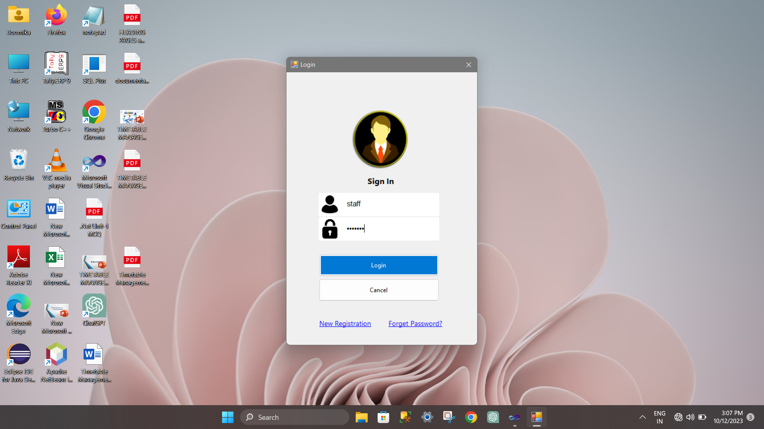
REPORT

Slide 19
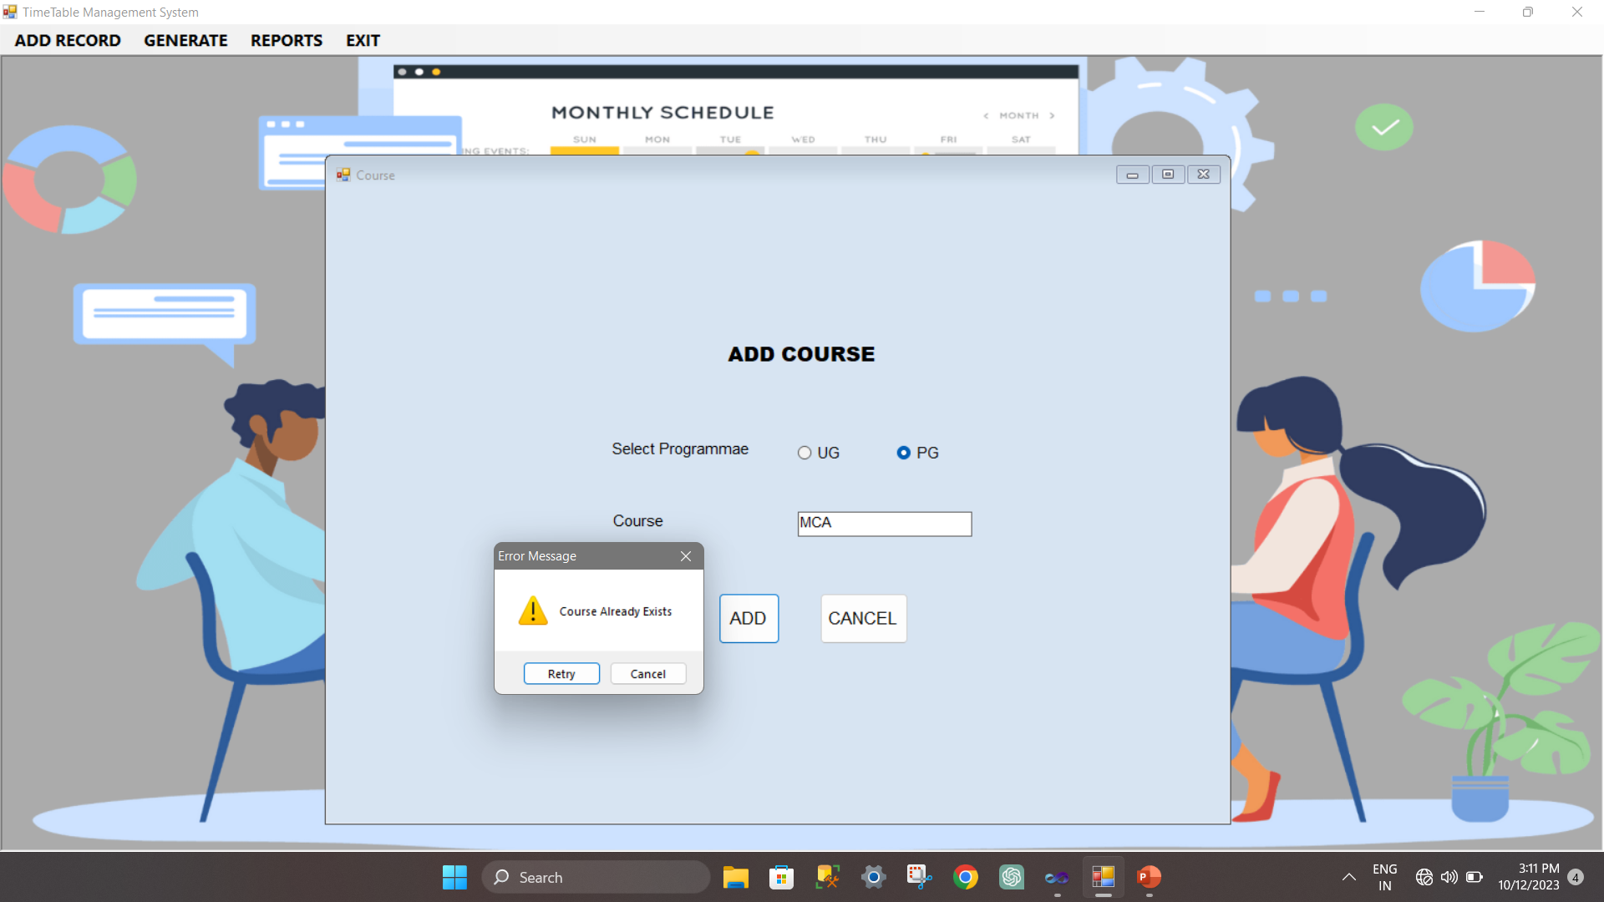

Slide 20
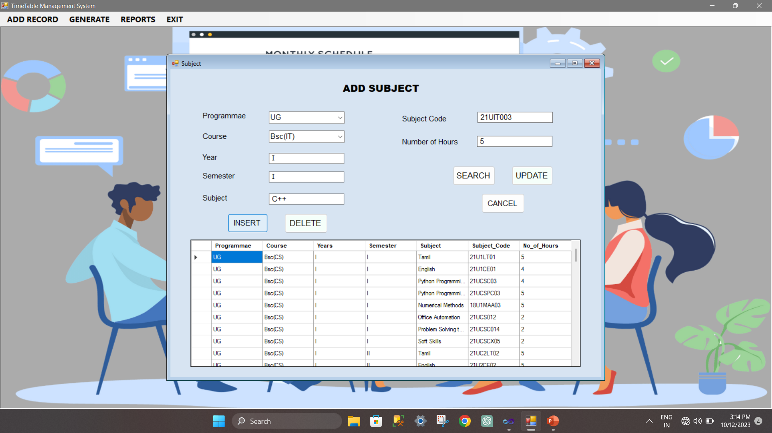

Slide 21
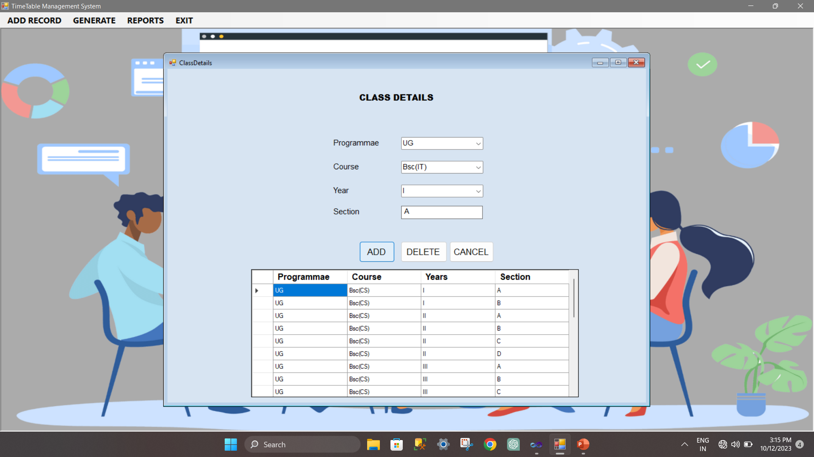

Slide 22
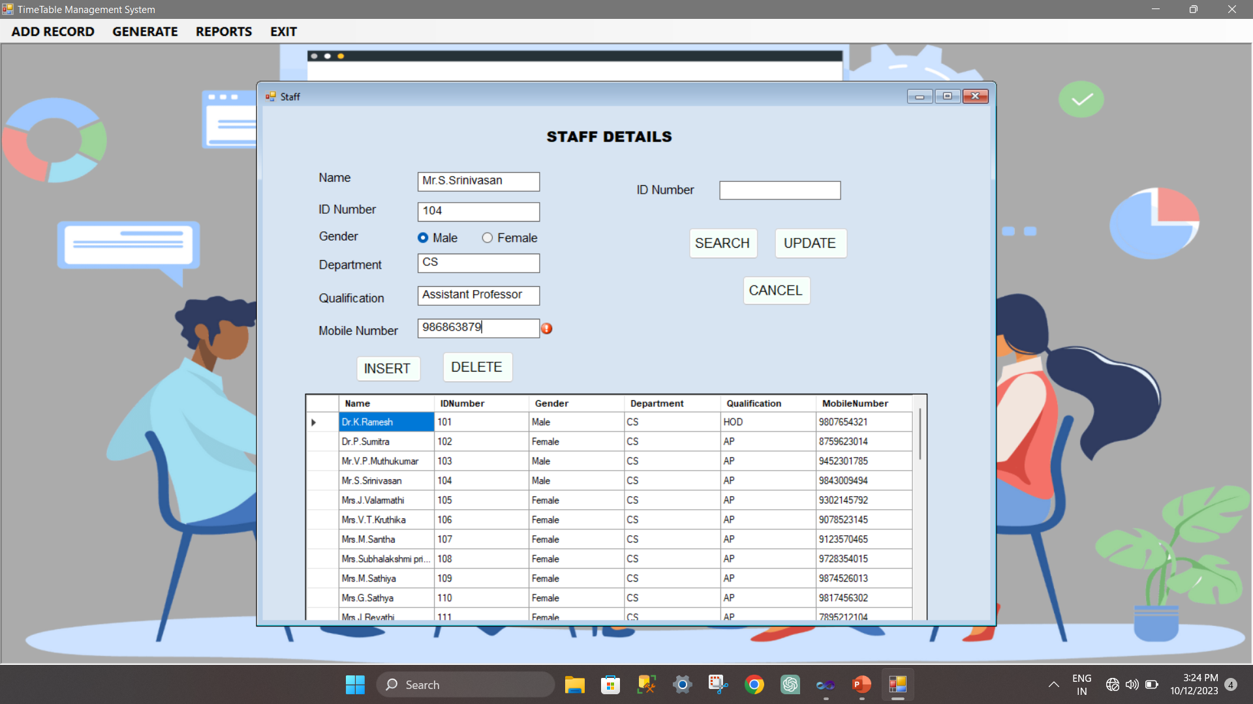

Slide 23
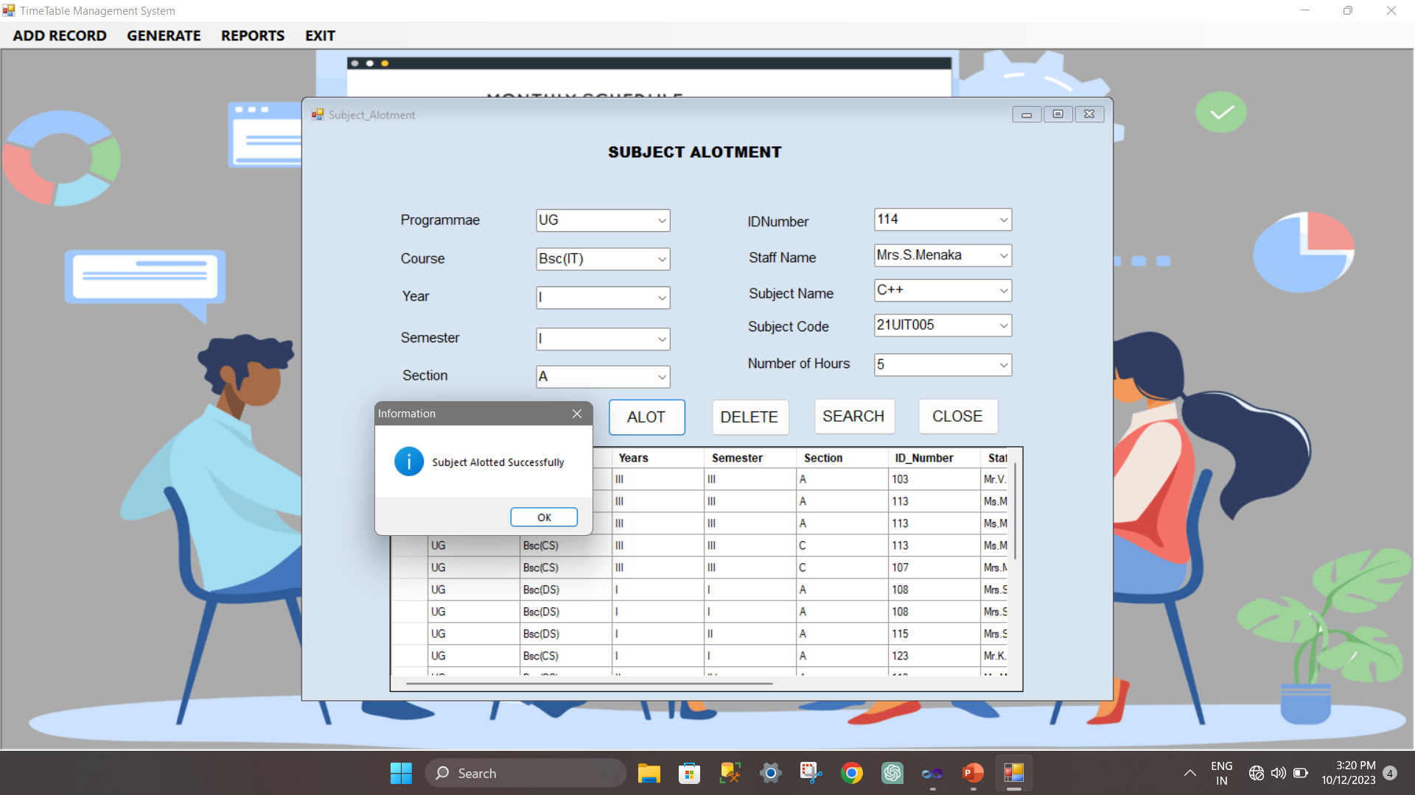

Slide 24
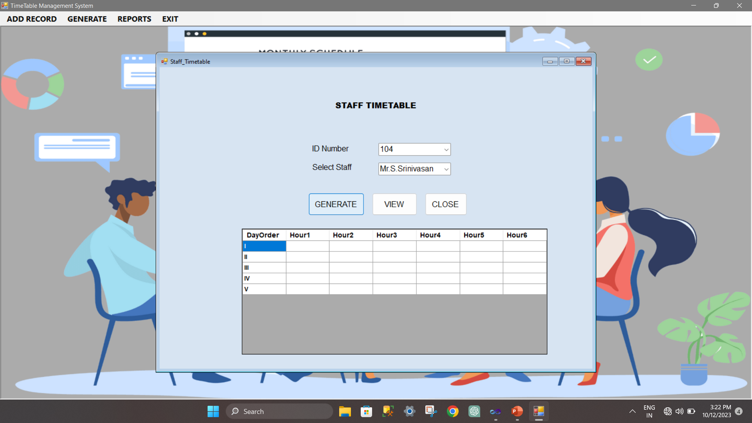

Slide 25
THANK YOU!!..

